Slide 1
VLSI PROJECT
Design and Implement CVU- Control Vector Unit for VGIW Archeticture
Students: Rabea Mahajna, Kamal Khateb
Supervised by: Goel Samuel, Dani Voitsechov

Slide 2
Reminder

Slide 3
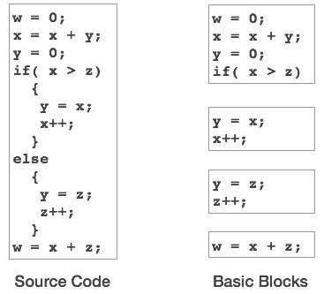
Terminology
BBs- basic blocks:
  Sequence of commands with single entry and single exit.
  Example:
r

Slide 4
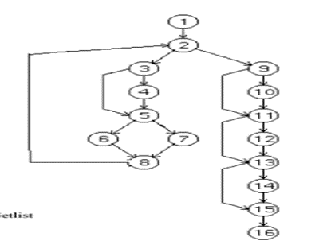
Control-Flow graph
Represents all possible execution paths for a program
Control flow statements (branches, jumps…) determine
a single path.
r

Slide 5
VGIW-Vector Graph Instruction Word

Slide 6
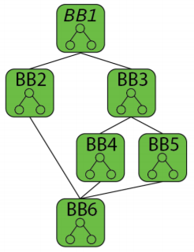
The VGIW Architecture vector graph instruction word
Break each kernel to it’s basic blocks
Produce a dataflow graph for each BB
Overcoming the complexity of mapping the whole kernel at once
r

Slide 7
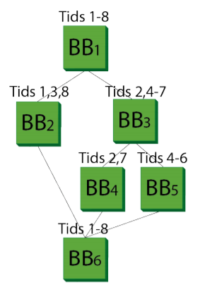
Life span of a kernel
Control- Dataflow represents our program
Nodes represent BBS
Threads take different paths depending the outcome of
the control statement at the end of the BB
For example: Tid 2 takes the highlighted path

Slide 8
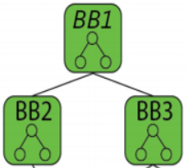
Life span of a kernel
Running BB1=>
1
2
3
4
5
6
7
8

Slide 9
Architectural components

Slide 10
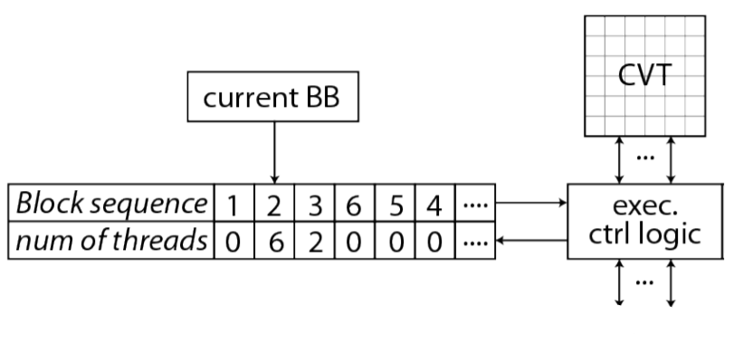
BBS scheduler – from project A
CVT: control vector table
To fabric
r

Slide 11
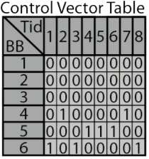
Top level view
CVT- Control Vector Table
2D array that holds the program state
For each BB there is a matching row
Specifies which threads are waiting to run
each BB
To fabric
r

Slide 12
Top level view
BB-sequencer
Decide which BB to run
based on the CVT state
To fabric
r

Slide 13
Top level view
Exec ctrl logic
The controller of our component
Update the CVT state according to the
fabric
To fabric
r

Slide 14
CVT state
Reads and write form/to CVT are done with 64 bits bandwidth
Threads intiated
0 | 0 | 0 | 0 | 0 | 0 | 0 | 0
0 | 0 | 0 | 0 | 0 | 0 | 0 | 0
0 | 0 | 0 | 0 | 0 | 0 | 0 | 0
Running BB
1 | 1 | 1 | 1 | 1 | 1 | 1 | 1
1 | 1 | 1 | 1 | 1 | 1 | 1 | 1
1 | 1 | 1 | 1 | 1 | 1 | 1 | 1
Target 1
0 | 0 | 0 | 0 | 0 | 0 | 0 | 0
0 | 0 | 0 | 0 | 0 | 0 | 0 | 0
0 | 0 | 0 | 0 | 0 | 0 | 0 | 0
Target 2
0 | 0 | 0 | 0 | 0 | 0 | 0 | 0
0 | 0 | 0 | 0 | 0 | 0 | 0 | 0
0 | 0 | 0 | 0 | 0 | 0 | 0 | 0
Threads terminated
0 | 1 | 0 | 1 | 0 | 1 | 0 | 1
0 | 0 | 0 | 0 | 0 | 1 | 1 | 1
Fabric
1 | 0 | 1 | 0 | 1 | 0 | 1 | 0
1 | 1 | 1 | 1 | 1 | 0 | 0 | 0
1 | 1 | 1 | 1 | 1 | 1 | 1 | 1
r

Slide 15
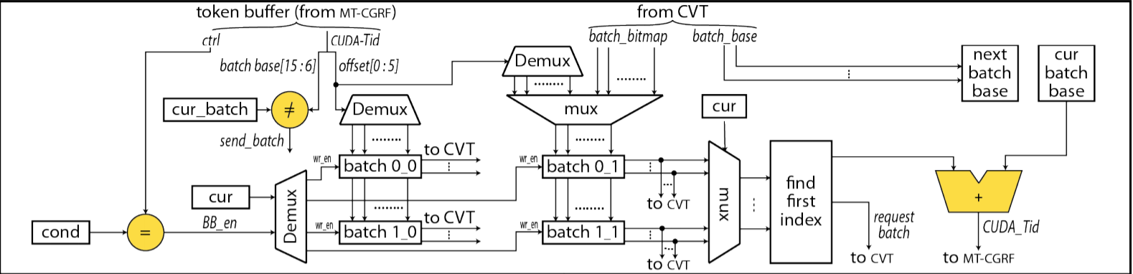
CVU – Control Vector Unit
Interface unit between BB scheduler and fabric
Each thread runs through the fabric independently of others
The CVU functions as both thread initiator and thread terminator
Initiator: receives packets from CVT and lauchens threads individually
Terminator: assembles threads back into packets and writes back
to the CVT.

Slide 16
CVU – schematic layout

Slide 17
CVU – Initiator
packets read from CVT
Received packets reside one of the available buffers
Threads are launched separately through the fabric
When one bucket drains out of threads switch to another and load a new bucket from CVT

Slide 18
CVU - Terminator
Threads received from fabric
Threads are checked to belong to the packet being accumulated
Received threads written to on of the available buffers.
Only one batch is in use at a time
On a mismatch the packets is written back to the CVT, and another buffer is used

Slide 19
SIMULATION

Slide 20
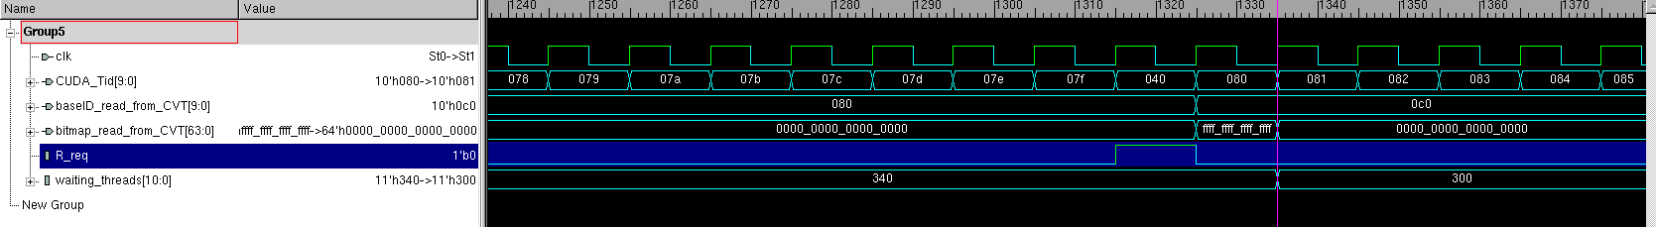
CVU-Initiator
Intiated threads IDs
Packet drained out, request another one
r

Slide 21
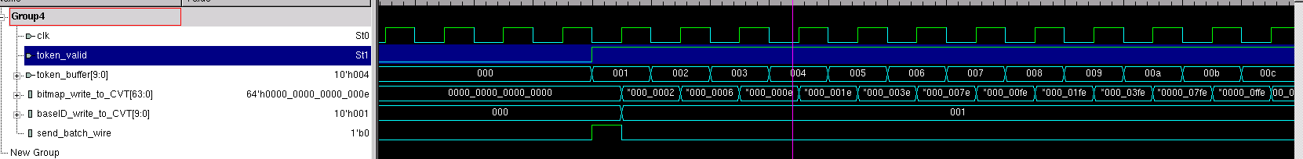
CVU-Terminator
Terminated TID
Accumulated terminated TID
Bitmap offset

Slide 22
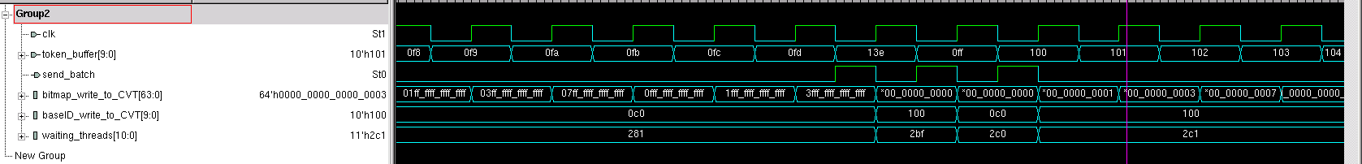
CVU-Terminator
Terminated thread out of current offset
TID within the same offset accumulated
Terminated TID
Accumulated terminated TID
Bitmap offset

Slide 23
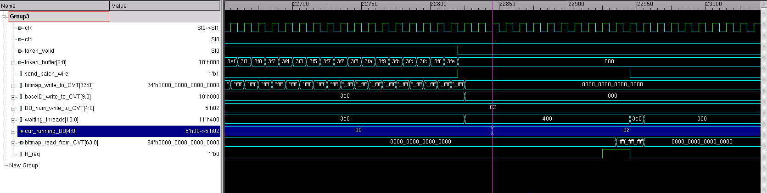
CVU-CVT Scheduling a new BB
Terminated threads ID

Slide 24
SUMMARY

Slide 25
We gain a brief knowledge on GPGPUs and some of the modern architectures in this field
Our main focus was on the VGIW architecture.
Gain more experience in programing with systemverilog
Improved our skills in hardware designing and implementing
Improved our teamwork skills

Slide 26
Q&A

